Slide 1
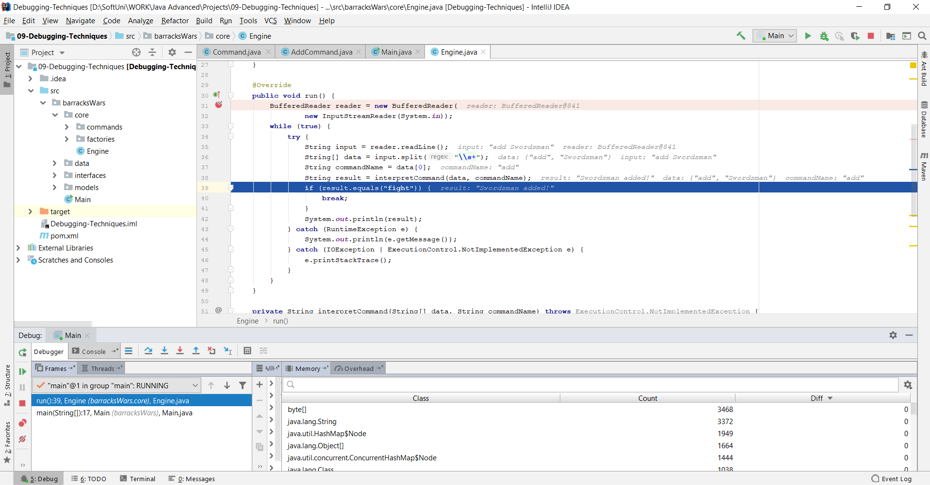

Debugging
Building Rock-Solid Software
SoftUni Team
Technical Trainers
Software University
https://softuni.bg

Slide 2
Table of Contents
Introduction to Debugging
IntelliJ IDEA Debugger
Breakpoints
Data Inspection
Finding a Defect

Slide 3
Have a Question?
sli.do
#java-advanced

Slide 4

Introduction to Debugging

Slide 5
What is Debugging?
The process of locating and fixing or bypassing bugs (errors) in computer program code
To debug a program:
Start with a problem
Isolate the source of the problem
Fix it
Debugging tools (called debuggers) help identify coding errors at various development stages

Slide 6
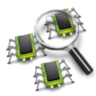
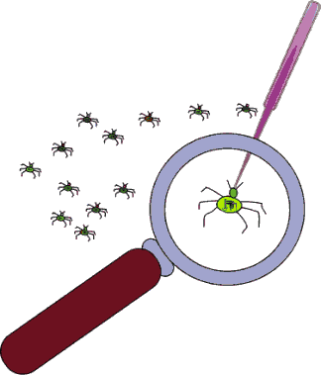
Debugging vs. Testing
Testing
A means of initial detection of errors
Debugging
A means of diagnosing and correcting the root causes of errors that have already been detected
Notes:
Some programmers use the terms "testing" and "debugging" interchangeably, but careful programmers distinguish between the two activities.
Testing is a means of detecting errors. Debugging is a means of diagnosing and correcting the root causes of errors that have already been detected.

Slide 7
Importance of Debugging
$60 Billion per year in economic losses due to software defects
E.g. the Cluster spacecraft failure was caused by a bug
Perfect code is an illusion
There are factors that are out of our control
Legacy code
You should be able to debug code that is written years ago
A deeper understanding of the system as a whole

Slide 8
Debugging Philosophy
Debugging can be viewed as one big decision tree
Individual nodes represent theories
Leaf nodes represent possible root causes
Traversal of tree boils down to process state inspection
Minimizing time to resolution is key
Careful traversal of the decision tree
Pattern recognition
Visualization and ease of use helps minimize time to resolution

Slide 9


IntelliJ IDEA Debugger

Slide 10
IntelliJ IDEA Debugger
IntelliJ IDE gives us a lot of tools to debug your application
Adding breakpoints
Visualize the program flow
Control the flow of execution
Data tips
Watch variables
Debugging multithreaded programs
And many more…

Slide 11
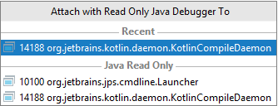
How to Debug a Process
Starting a process under the IntelliJ debugger
Attaching to an already running process
Without a solution loaded you can still debug
Useful when a solution isn't readily available
Ctrl + Alt + F5

Slide 12
Debugging a Project
Right click in main method, Debug '{class}.main()'
Shift + F9 is a shortcut
Easier access to the source code and symbols since its loaded in the solution
Certain differences exist in comparison to debugging an already running process

Slide 13
Debug Windows
Debug Windows are the means to introspect on the state of a process
Opens a new window with the selected information in it
Window categories
Frames / Threads
Variables
Watches
Accessible from Debug window

Slide 14
Debugging Toolbar
A convenient shortcut to common debugging tasks
Step over – F8
Force Step Into – through the method calls - Alt + Shift + F7
Step Out – Shift + F8
Step into – F7
Continue
Break
Breakpoints

Slide 15
Controlling Execution
By default, an app will run uninterrupted (and stop on exception or breakpoint)
Debugging is all about looking at the state of the process
Controlling execution allows:
Pausing execution
Resuming execution

Slide 16
Options and Settings
IntelliJ offers quite a few knobs and tweaks in the debugging experience
Options and settings is available via Settings/Preferences -> Build, Execution and Deployment (Ctrl + Alt + S):
Debugger -> Data Views -> Java
Compiler -> Java Compiler
Project Structure (Ctrl + Shift + Alt + S)

Slide 17

Breakpoints

Slide 18
Breakpoints
The ability to stop execution based on certain criteria is key when debugging
When a function is hit
When data changes
When a specific thread hits a function
Much more…
IntelliJ's debugger has a huge feature set when it comes to breakpoints

Slide 19
IntelliJ IDEA Breakpoints
Stops execution at a specific instruction (line of code)
Can be set using:
Ctrl + F8 shortcut
Clicking on the left most side of the source code window
By default, the breakpoint will hit every time execution reaches the line of the code
Additional capabilities: condition, hit count, value changed, when hit, filters

Slide 20
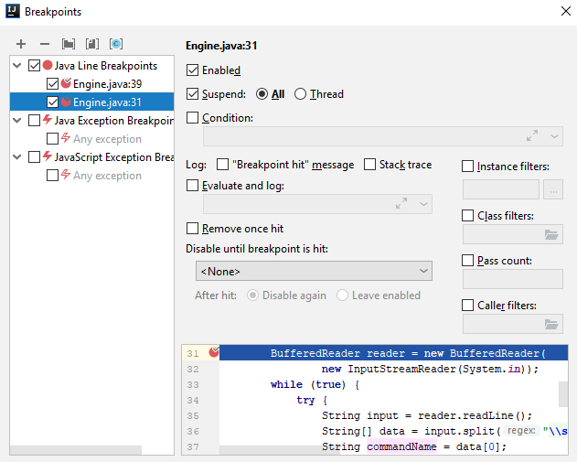
Managing Breakpoints
Managed in the breakpoint window
Adding breakpoints
Removing or disabling breakpoints
Open Breakpoints window
Ctrl + Shift + F8

Slide 21

Data Inspection

Slide 22
Data Inspection
Debugging is all about data inspection
What are the local variables?
What is in memory?
What is the code flow?
In general - What is the state of the process right now and how did it get there?
As such, the ease of data inspection is key to the quick resolution of problems

Slide 23
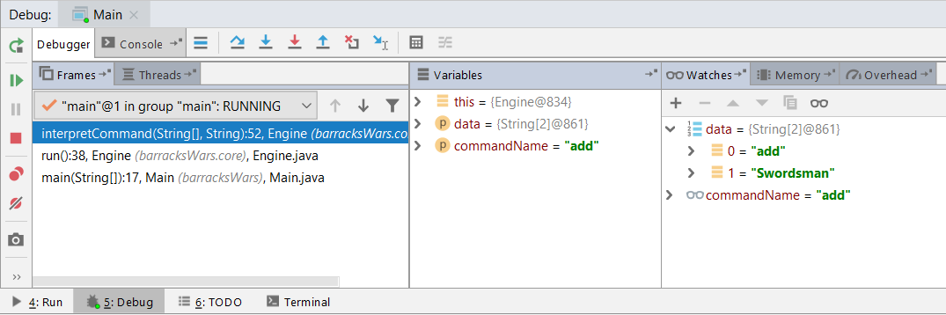
IntelliJ Data Inspection
IntelliJ offers great data inspection features
Variables
Watches
Memory
Overhead

Slide 24
Variables and Watches Windows
Allows you to inspect various states of your application
Several different kinds of "predefined" watches window
"Custom" watches windows are also possible
Contains only variables that you choose to add
Right click on the variable and select "Add to Watches"
Write the variable name in the Watches window

Slide 25
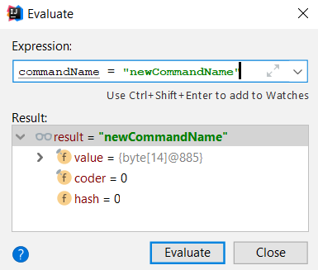
Evaluate Expression Window
Enables to evaluate expressions and code fragments in the context of a stack frame
Also evaluate operator expressions, lambda expressions, and anonymous classes
Shortcut – Alt + F8

Slide 26
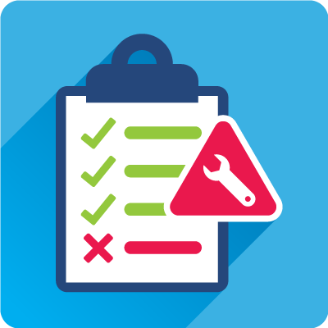
Finding a Defect

Slide 27
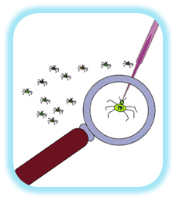
Finding a Defect
Stabilize the error
Locate the source of the error
Gather the data
Analyze the data and form a hypothesis
Determine how to prove or disprove the hypothesis
Fix the defect
Test the fix
Look for similar errors

Slide 28

Tips for Finding Defects (1)
Use all available data
Refine the test cases
Check unit tests
Use available tools
Reproduce the error in several different ways
Generate more data to generate more hypotheses
Use the results of negative tests
Brainstorm for possible hypotheses

Slide 29
Tips for Finding Defects (2)
Narrow the suspicious region of the code
Be suspicious of classes and routines that have had defects before
Check code that's changed recently
Expand the suspicious region of the code
Integrate incrementally
Check for common defects
Talk to someone else about the problem
Take a break from the problem

Slide 30

Fixing a Defect
Understand the problem before you fix it
Understand the program, not just the problem
Confirm the defect diagnosis
Relax
Save the original source code
Fix the problem, not the symptom
Make one change at a time
Add a unit test that exposes the defect
Look for similar defects
Source: http://www.movingseniorsbc.com

Slide 31
Psychological Considerations
Your ego tells you that your code is good and doesn't have a defect even when you've seen that it has
How "psychological set" contributes to debugging blindness
People expect a new phenomenon to resemble similar phenomena they've seen before
Do not expect anything to work "by default"
Do not be too devoted to your code – establish psychological distance

Slide 32

Summary
…
…
…
Introduction to Debugging
IntelliJ IDEA Debugger
Breakpoints
Data Inspection
Variables, Watches, Frames
Finding a Defect

Slide 33
Questions?
Notes:
33

Slide 34













SoftUni Diamond Partners

Slide 35


Educational Partners

Slide 36
Trainings @ Software University (SoftUni)
Software University – High-Quality Education, Profession and Job for Software Developers
softuni.bg
Software University Foundation
softuni.foundation
Software University @ Facebook
facebook.com/SoftwareUniversity
Software University Forums
forum.softuni.bg
36
Notes:
36

Slide 37

License
This course (slides, examples, demos, exercises, homework, documents, videos and other assets) is copyrighted content
Unauthorized copy, reproduction or use is illegal
© SoftUni – https://about.softuni.bg
© Software University – https://softuni.bg
Notes:
37

